Slide 1
IOT Smart Fridge Tracker Final Presentation
COEN 243 Project
By Erik Wrysinski, Jack Gaul, Mubashir Hussain, Sebastian Buxman, and Swarom Saurabh Muley

Slide 2
User Pain Points
Users re-purchasing fridge items they have already.
Items not used soon enough leading to expiration.
Having the ability to see what’s in the fridge at any point.
Knowing as soon as the temperature in the fridge starts increasing. Which may tell the user their fridge is broken.

Slide 3
Status Quo solutions
Keeping a mental list of what you have at home
Manually keeping track of your groceries with a spreadsheet or note
Purchasing a dedicated Smart Fridge from companies like Samsung with remote camera access or even automatic item recognition built in
Cost prohibitive and not realistic for majority of people

Slide 4
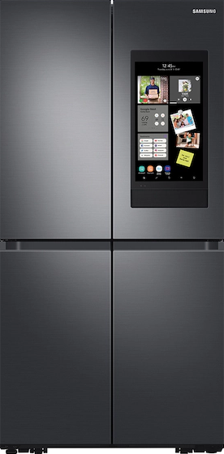

Prior Arts
Samsung Family Hub
Features live fridge view + item recognition with list generation
Requires purchasing fridge with these features built-in (Price 2x or more than fridges of similar capacity without this feature)
Amazon Go
Store with no cashiers, tracks all items to whoever picks them up and charges you when you leave
Requires weight sensors and cameras for each shelf, RFID tags, and tracking of each individual in the store

Slide 5

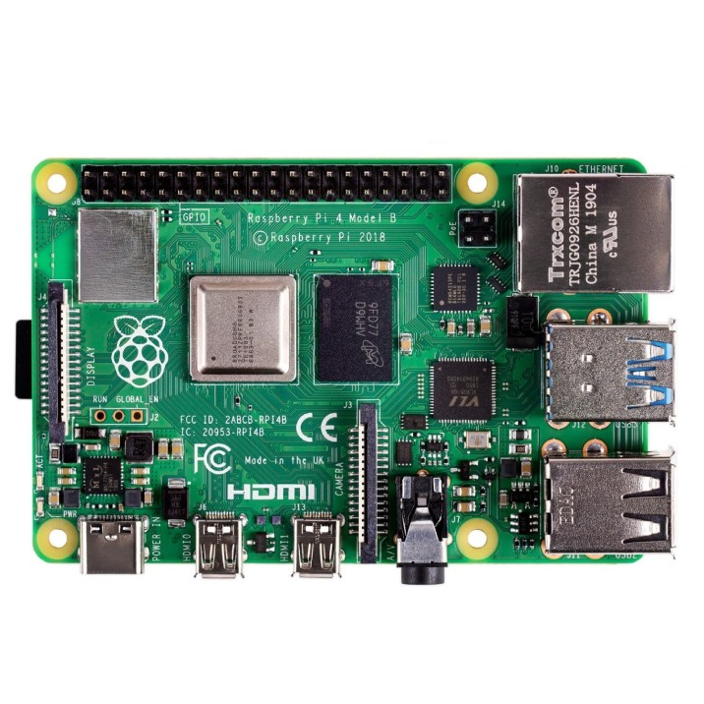
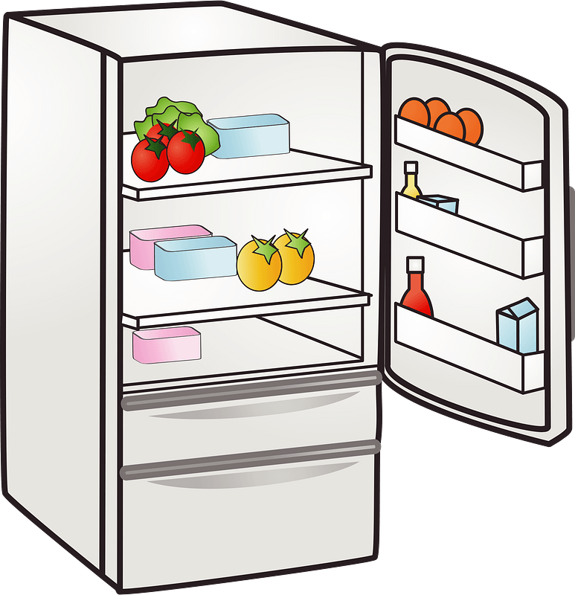
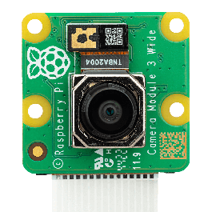
Final IoT System
Raspberry Pi with serial camera + temp/humidity sensor placed inside fridge
Using object recognition, adds items to cloud database as groceries are added to fridge
Keeps track of date/time they were added and calculates expiration date from public expiry data + sensor data
Database entries and sensor data are viewable from web portal with ability to edit by user in the case of incorrect/unrecognized items

Slide 6







Tools, Hardware, Software
Hardware
Raspberry Pi Unit + CSI Camera
Temperature/Humidity Sensor
Software
Linux
OpenAI API
OpenCV
Twilio/SendGrid/APNS
Cloud Computing
Amazon Web Services

Slide 7
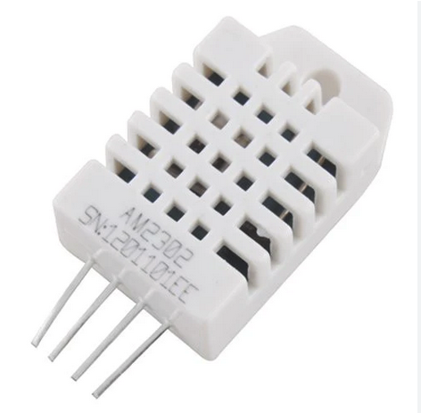
Temperature/Humidity Sensor
DHT 22 Sensor connected to the Raspberry PI.
Takes up 3 pins on the Pi and only has a temperature and humidity sensor.
Relatively straightforward to create a dashboard with the Flask API.
Cheaper than the Sensortag.

Slide 8
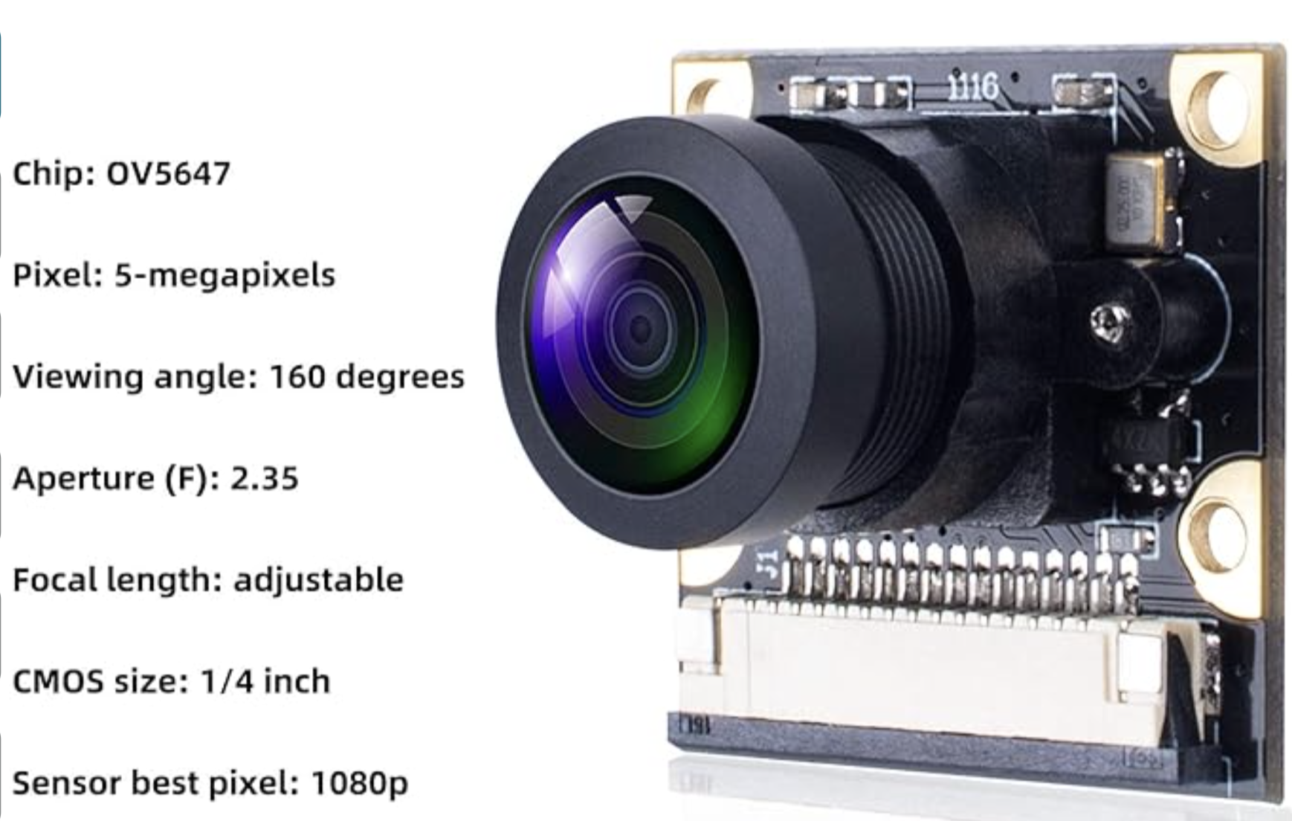
Camera
SMRAZA CSI Camera
5MP allowing for good enough quality for image classification while not requiring too many resources
160 degree FOV to allow close placement to items in fridge
Adjustable focal length to fit user setup

Slide 9
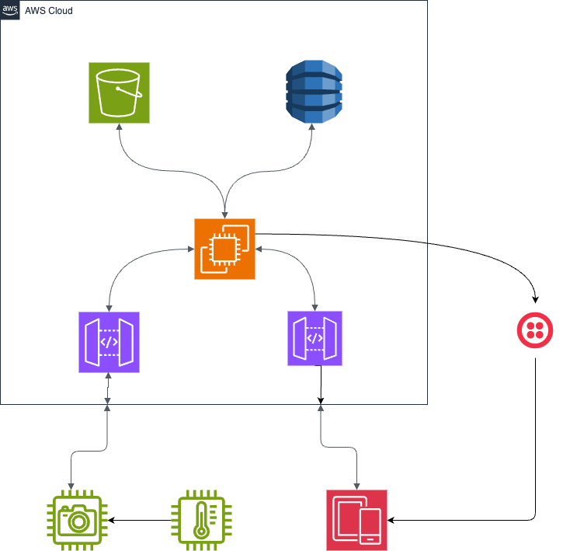
Backend Infrastructure
Raspberry Pi device communicates to web server to store information and communicate with mobile devices.
The temperature sensor will send data back to the raspberry pi via a serial connection.
Mobile Device will communicate with public API to retrieve user information.

Slide 10
Backend Infrastructure
EC2: Linux Server
Run Flask Server for API endpoints
Run cron job to:
Keep device connection alive
Check expiration date list in DB
DynamoDB: noSQL DB for all state information
Twilio: Notification Service
OpenAI: Recipe Suggestio

Slide 11
Feature List
Temperature and Humidity Sensing:
Monitors fridge climate for optimal food preservation.
Temperature Alerts:
Sends notifications for temperature deviations.
Expiration Date Prediction:
Estimates expiration dates for unpackaged foods to reduce waste.
Expiration Alerts:
Notifies users about items nearing expiration.
Automated Image Recognition:
Classifies and adds items to inventory through database synchronization.

Slide 12
Features List Cont.
Real-time Fridge Snapshot:
Provides the latest view of fridge contents via the app for easy recall.
Correctable Classification:
Auto-identifies items with an option for user correction on unrecognized items.
On-Screen Feedback:
Indicates active image capture for user assurance.

Slide 13
Features List Cont.
Meal Suggestion and guide
Given what you have in the fridge, the app can suggest meals to make.

Slide 14
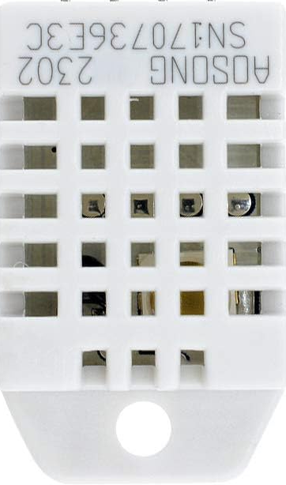
IoT System Operation
Temperature/Humidity sensor retrieves data at customizable intervals (default is 15 min)
Updated fridge photo captured at user request with button press, ideally when they are done using fridge
When loading new items, user can hold item in front of camera and press button to scan and automatically categorize it
Visual feedback to ensure user knows item is captured
Data sent to cloud for display and potential edits in-app

Slide 15
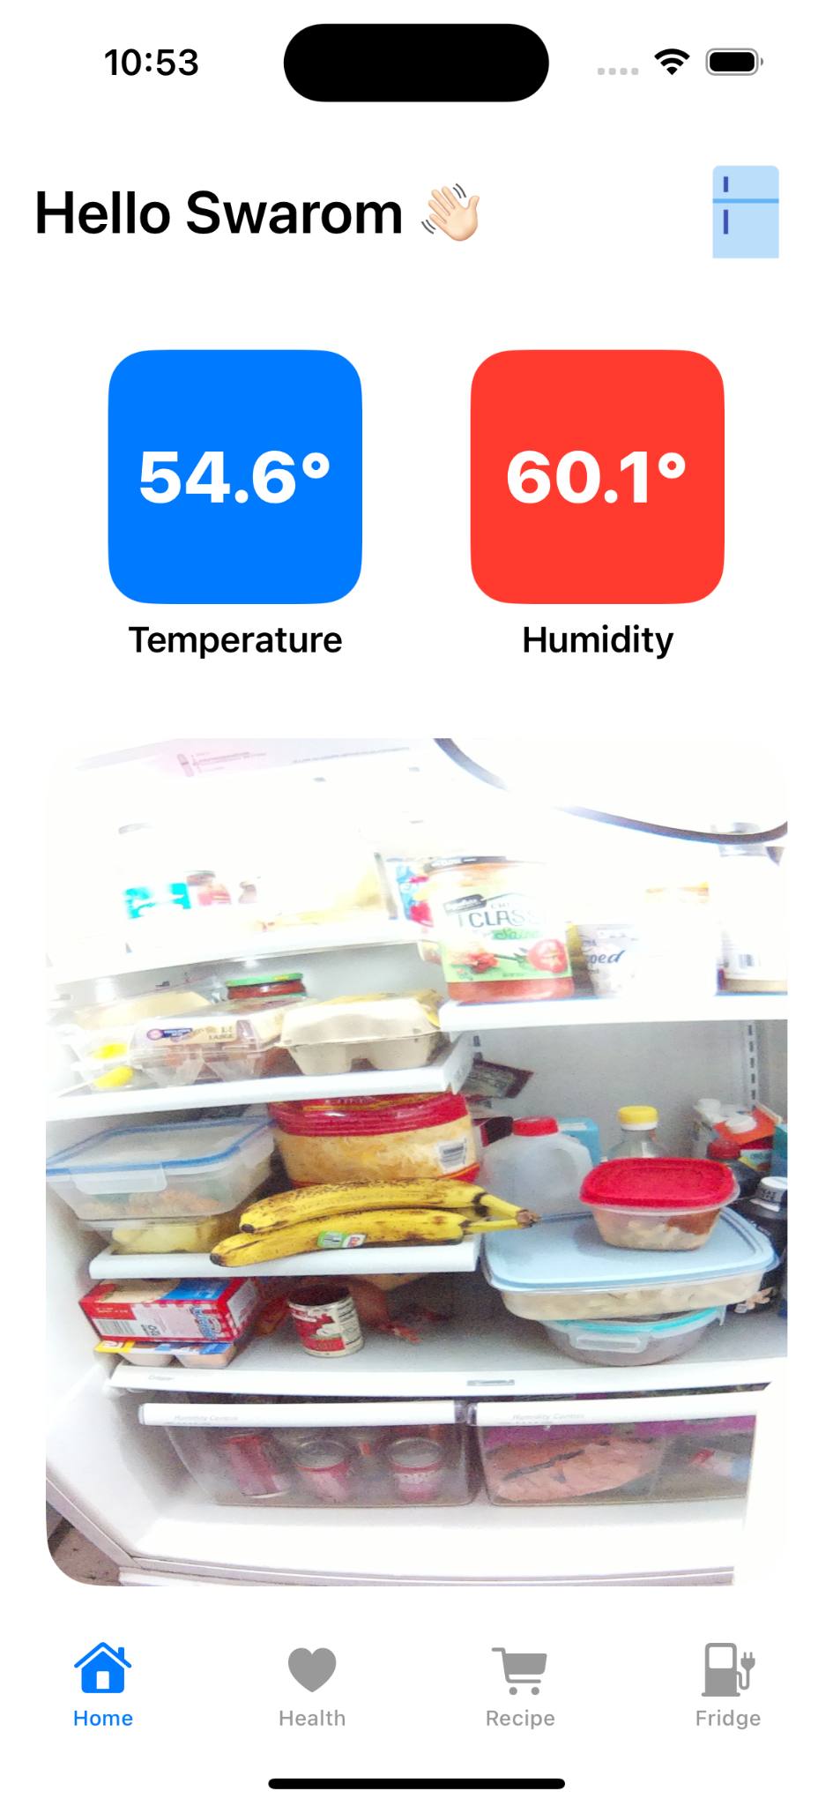
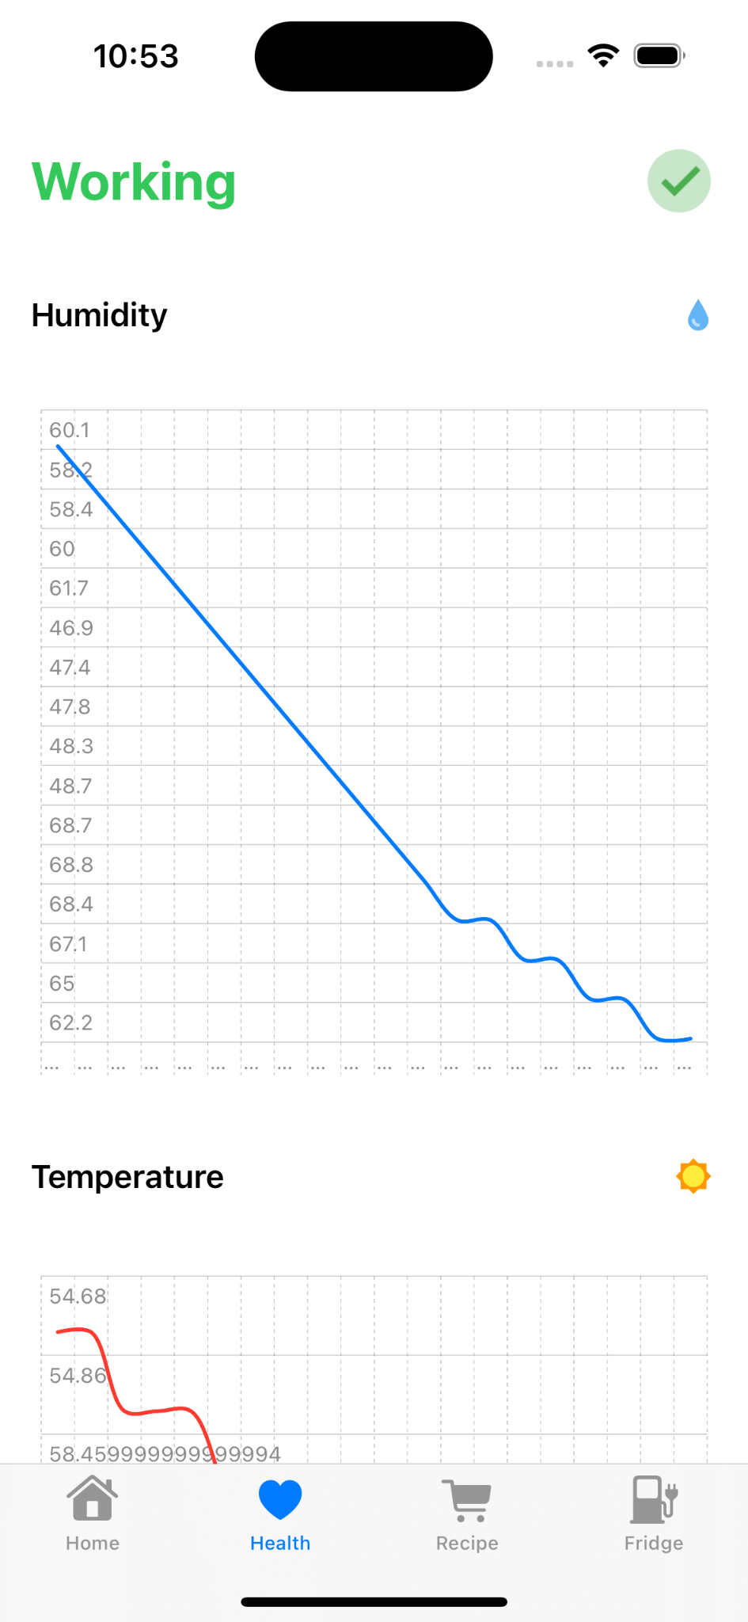
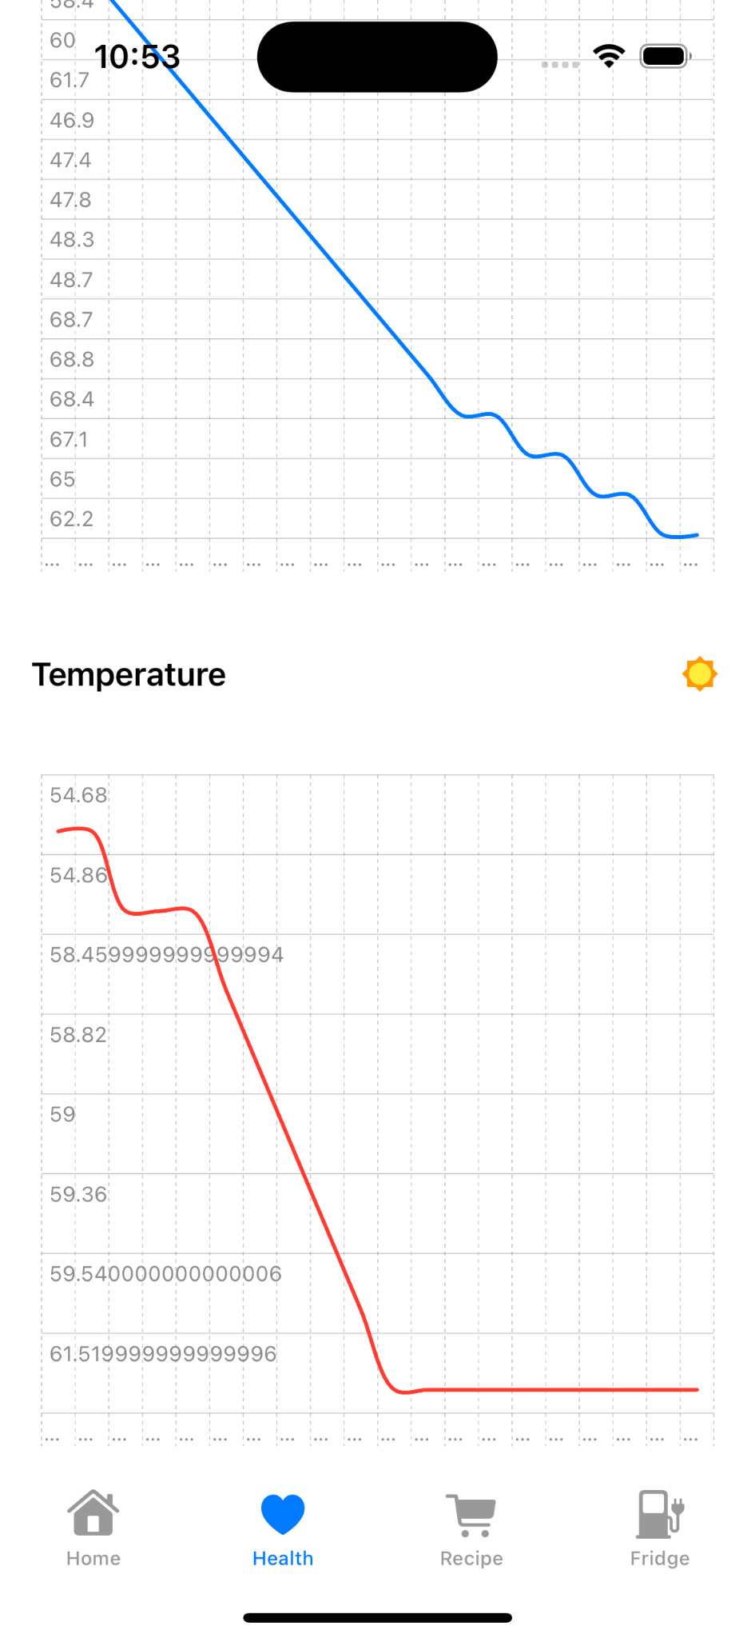
Home page showing real-time temperature, humidity and snapshot of the fridge.
Health page showing the temperature and humidity levels over a time interval.

Slide 16
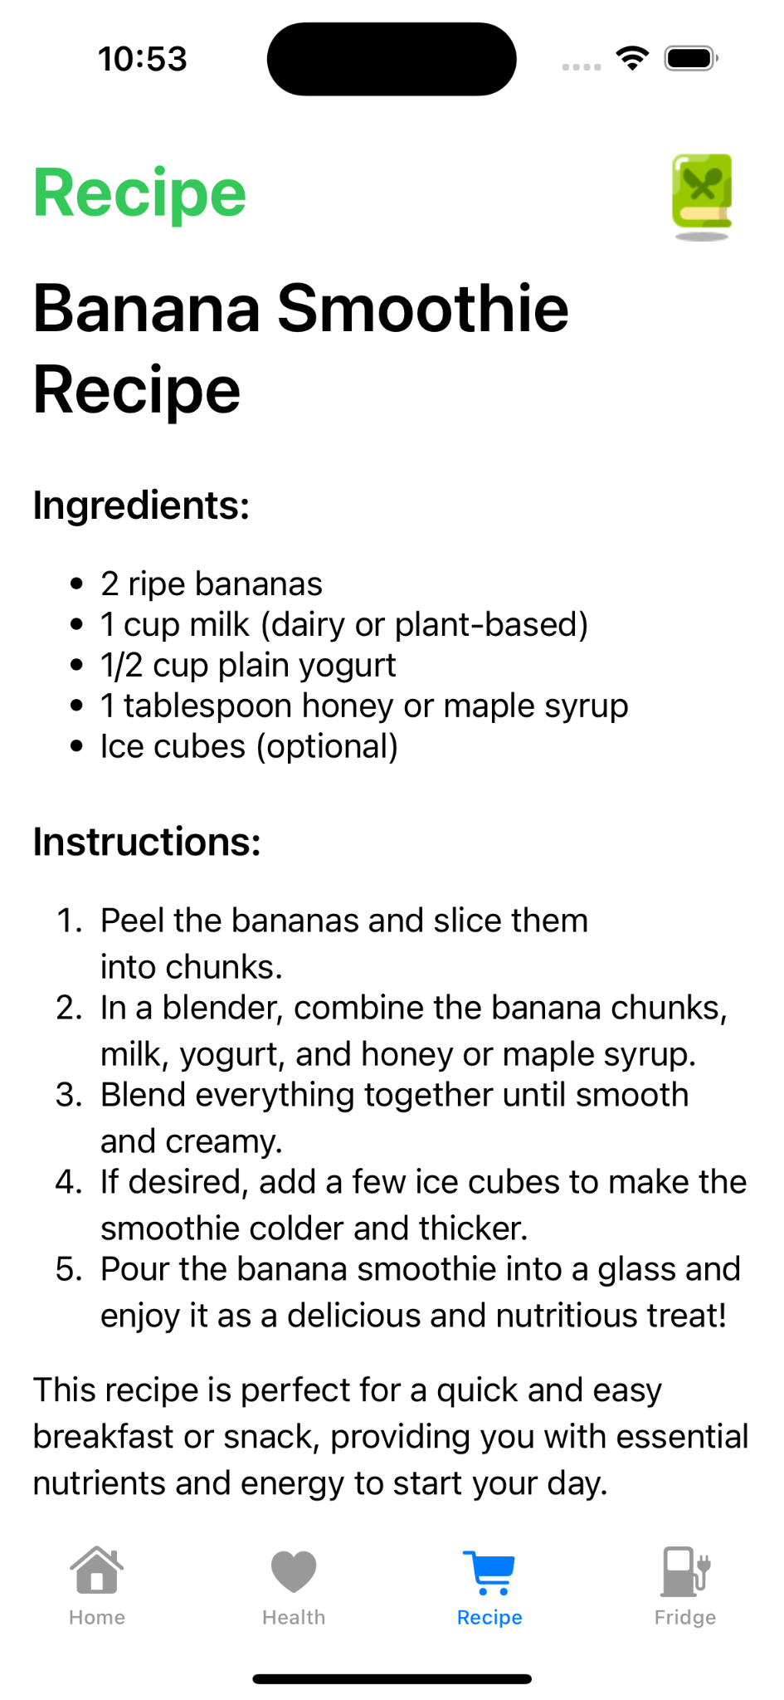
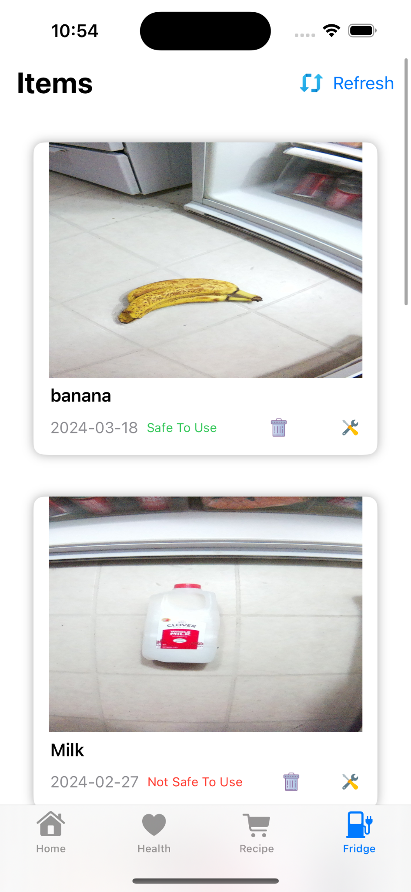
Recipe page showing possible recipes based on items in the fridge.
Fridge page showing snapshots of items placed in the fridge. Identified through the classification model.

Slide 17
Key Learnings
Originally wanted to implement ML algorithms to allow for more accurate expiration date prediction - opted with a rule based algorithm because we had a lack of training data.
Open source image classification models have limits due to poor quantity or quality of training data, making it difficult to find one that works perfectly in a wide variety of environments with our camera
Configuring security with cloud computing, and ensuring edge devices have appropriate permissions.

Slide 18
Ideas for future work
Train our own custom food recognition model with multiple fridge and camera combinations for better accuracy.
Implement an ML algorithm for expiration dates.
Enhance equipment for durability and setup in the fridge.
Design custom enclosure for device + sensors for easy camera pivoting and display viewing.
Find hardware solution to automatically capture image upon fridge opening/closing
Test system in wide variety of fridges to gather data on ideal temperature/humidity sensor placement for best accuracy.

Slide 19
Task Distributions
Erik - Implement raspberry pi and code to take pictures via button with live display on the CSI
camera, alongside implementing final device code for uploading data.
Assist with backend implementation.
Jack - Create and maintain backend infrastructure using AWS, Linux and OpenAi API
Create smart shopping list.
Assisted overall with many different tasks with bug fixes and road blocks.
Camera side network request calls.
Implement notifications using Twilio.
Mubashir- Source and implement an image classification model to correctly identify items inside the
fridge. Support with connecting model and raspberry pi camera to upload pictures.
Sebastian- Predicting/analyzing temperature/humidity and lifespan of items in the fridge.
Temperature and humidity sensor purchase and code set up.
Swarom - Create and implement swift app combining the different elements of the project into
one application.

Slide 20
Thank you!
Any questions?
By Erik Wrysinski, Jack Gaul, Mubashir Hussain, Sebastian Buxman, and Swarom Saurabh Muley

